Slide 1
Deep dive into DevOps for
Azure Logic Apps
Raihan Alam
4th September, 2019

Slide 2
Deep dive into DevOps for
Azure Logic Apps
Raihan Alam
4th September, 2019
Big data / Cloud Consultant, Caltex C-lab

Slide 3
Deep dive into DevOps for
Azure Logic Apps
Raihan Alam
4th September, 2019
Big data / Cloud Consultant, Caltex C-lab
Build big data solutions in Cloud, sometimes they work!

Slide 4
This session is NOT

Slide 5
This session is NOT
Logic App 101
ARM Template 101
DevOps 101
Azure 101
Real estate investment 101

Slide 6
This session is NOT
Logic App 101
ARM Template 101
DevOps 101
Azure 101
Real estate investment 101

Slide 7
This session is NOT
Logic App 101
ARM Template 101
DevOps 101
Azure 101
Real estate investment 101

Slide 8
This session is NOT
Logic App 101
ARM Template 101
DevOps 101
Azure 101
Real estate investment 101

Slide 9
This session is NOT
Logic App 101
ARM Template 101
DevOps 101
Azure 101
Philosophy & Logic 101

Slide 10
This session IS
DevOps for Logic App
Tools & limitations

Slide 11
This session IS
DevOps for Logic App
Tools & limitations

Slide 12
This session IS
DevOps for Logic App
Tools & limitations

Slide 13
This session IS
DevOps for Logic App
Tools & limitations

Slide 14
DevOps…..huh!

Slide 15
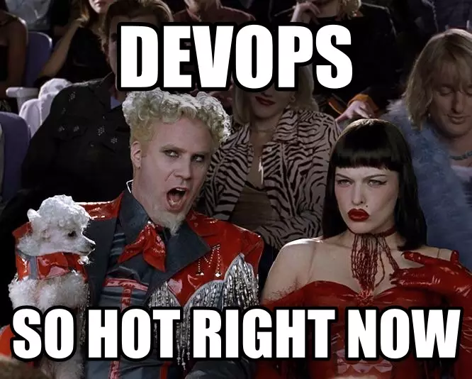
DevOps…..huh!

Slide 16
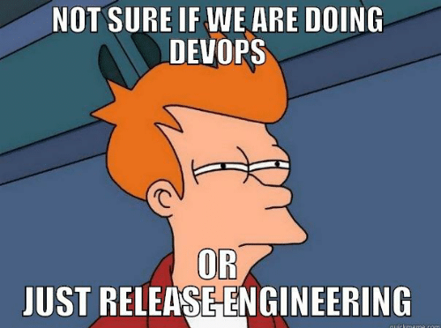
DevOps…..huh!

Slide 17
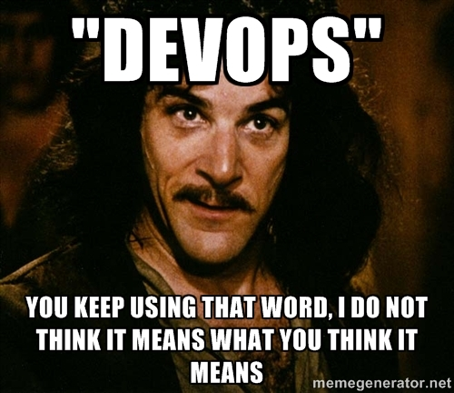
DevOps…..huh!

Slide 18
Scope of DevOps
Version control
Multi environment release pipeline
Configuration as code

Slide 19
Scope of DevOps
Version control
Multi environment release pipeline
Configuration as code

Slide 20
Scope of DevOps
Version control
Multi environment release pipeline
Configuration as code

Slide 21
Scope of DevOps
Version control
Multi environment release pipeline
Configuration as code

Slide 22
Version control, Multi environment release pipeline & Configuration as code for Azure Logic App

Slide 23
Version control, Multi environment release pipeline & Configuration as code for Azure Logic App
Not sellable

Slide 24
Version control, Multi environment release pipeline & Configuration as code for Azure Logic App
DevOps for Azure Logic Apps
Not sellable

Slide 25
Version control, Multi environment release pipeline & Configuration as code for Azure Logic App
DevOps for Azure Logic Apps
Not sellable
Not quite there yet

Slide 26
Version control, Multi environment release pipeline & Configuration as code for Azure Logic App
DevOps for Azure Logic Apps
Deep dive into DevOps for Azure Logic Apps
Not sellable
Not quite there yet

Slide 27

Version control, Multi environment release pipeline & Configuration as code for Azure Logic App
DevOps for Azure Logic Apps
Deep dive into DevOps for Azure Logic Apps
Not sellable
Not quite there yet

Slide 28
Audience
Mere mortals
(aka people who uses visual tool to build logic apps)

Slide 29
Rules Requests
No need to take notes
(https://github.com/ra1han/logicapp-devops.git)
Interrupt and keep asking questions

Slide 30


Tools
Azure Portal
Azure DevOps
VS 2019 - Ext. Azure Logic Apps Tools for Visual Studio 2019
VS Code – Ext. Azure Logic Apps Preview

Slide 31
Dev
Prod
Dev - Azure Sydney Meetup
(fb/devlogicapp)
Logic App: syncSocial-dev
Resource Group: syncsocial-dev
Branch: develop
Prod - Azure Sydney Meetup
(fb/prodlogicapp)
Logic App: syncSocial-prod
Resource Group: syncsocial-dev
Branch: master

Slide 32
Showtime…

Slide 33
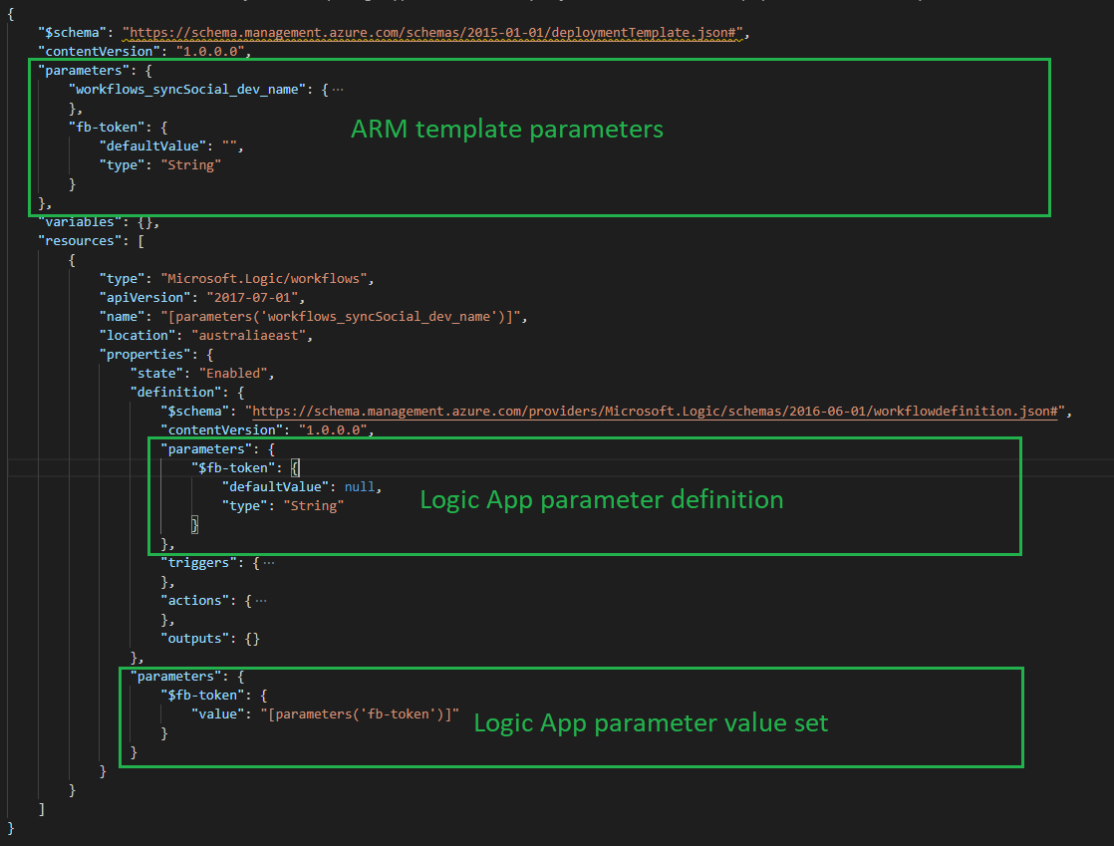

Slide 34
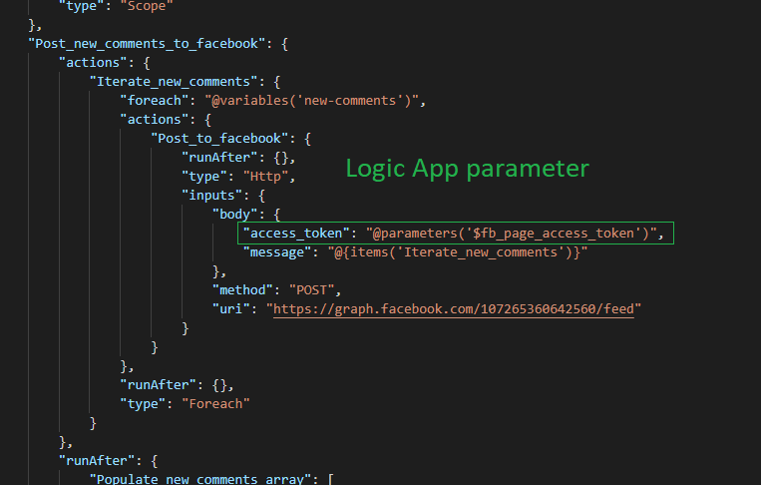
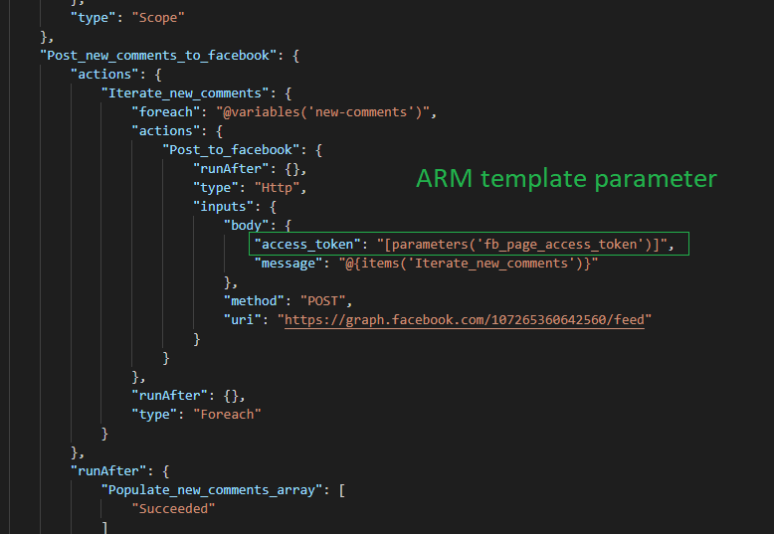

Slide 35


Slide 36
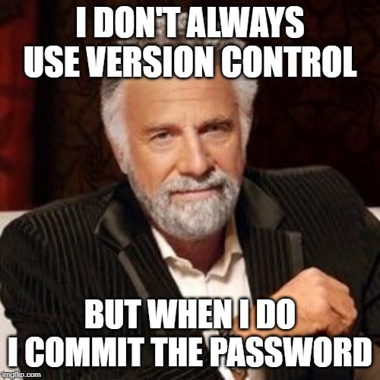

Slide 37
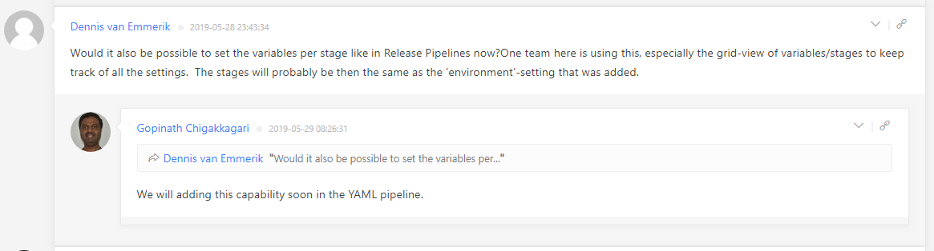
https://devblogs.microsoft.com/devops/whats-new-with-azure-pipelines/

Slide 38
Links
Separation of Concerns: Logic App from ARM Template
by Paco de la Cruz
Preparing Azure Logic Apps for CI/CD using ARM Templates
by Justin Yoo

